Slide 1

Trac.kr CS290-B Scalable Internet Services UCSB Fall 2013
Nazli Dereli
Dibyendu Nath
Arvind C R
Divya Sambasivan

Slide 2
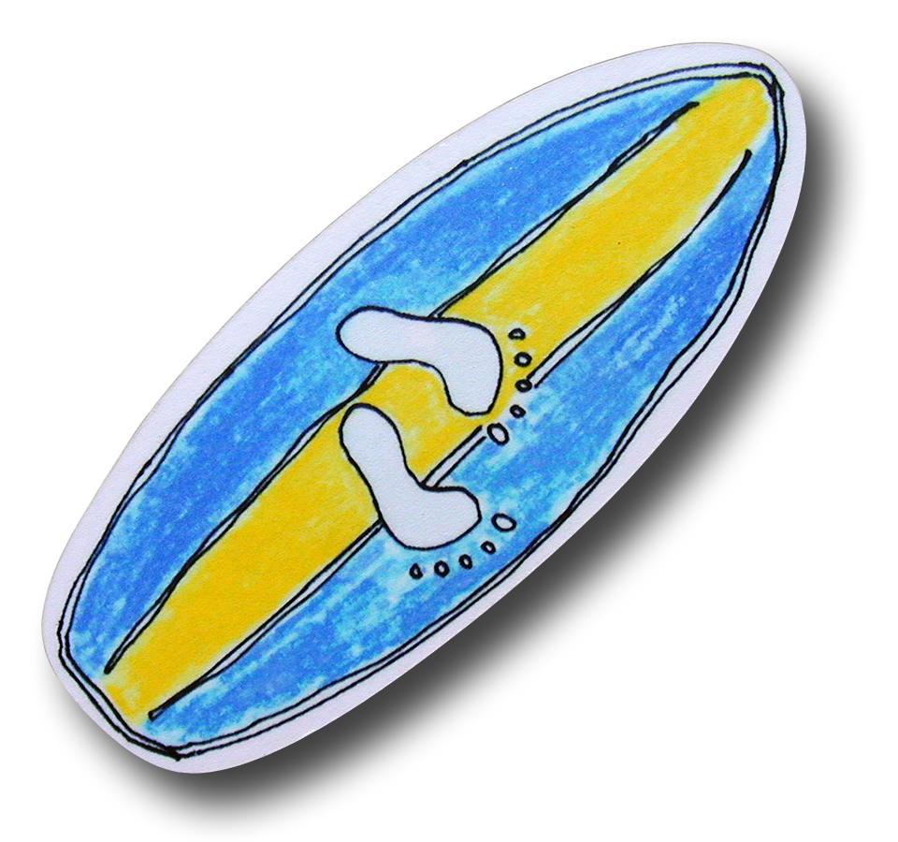
Why do we need Trackr?
Have you ever wanted to learn surfing?
Do you really want to finish reading that book?
Is it impossible to lose some pounds?
Just create a goal and find some friends to join!
Follow each other’s progress, cheer on and get motivated to
complete your ever-haunting goals!

Slide 3
Features
Facebook Integration
Search for Goals
Create New Goals
Set Milestones
Cheer on
Charts

Slide 4
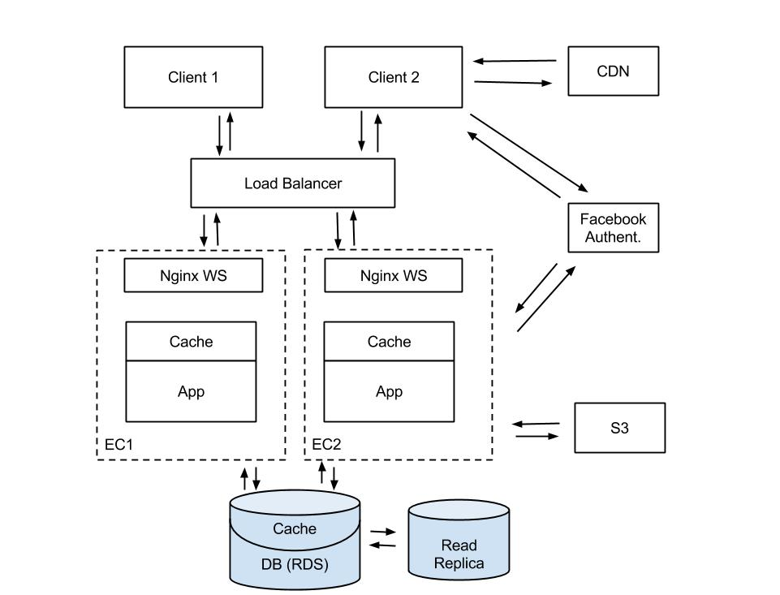
Our Architecture

Slide 5
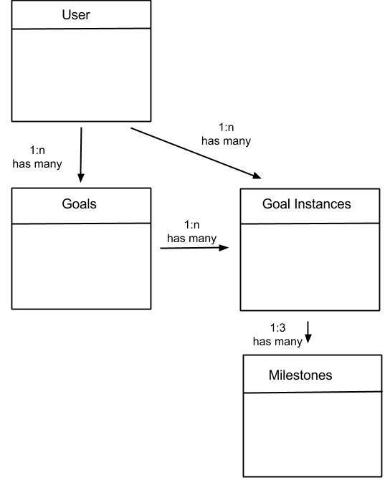
Our Database Model

Slide 6

Optimization

Slide 7
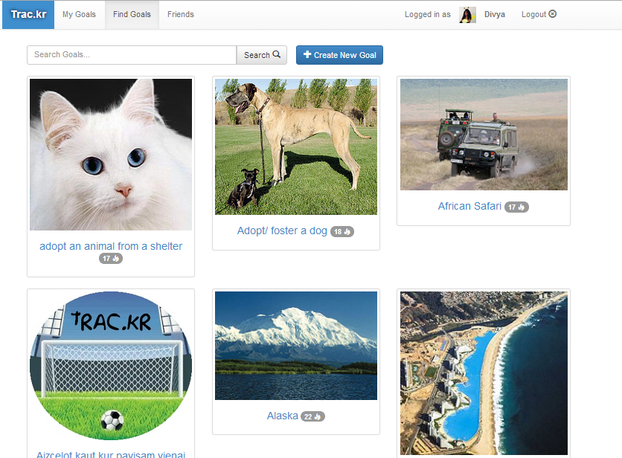
Database Indexing
100 – 200 % increase

Slide 8
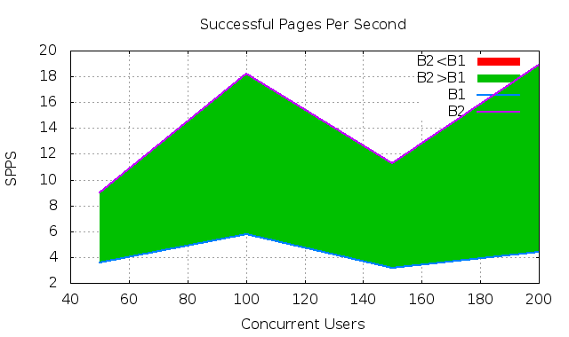
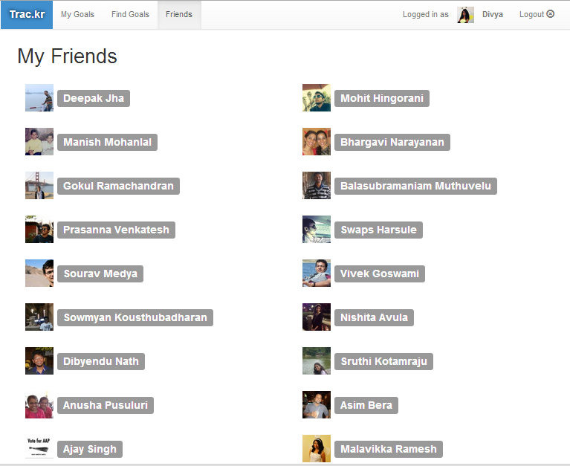
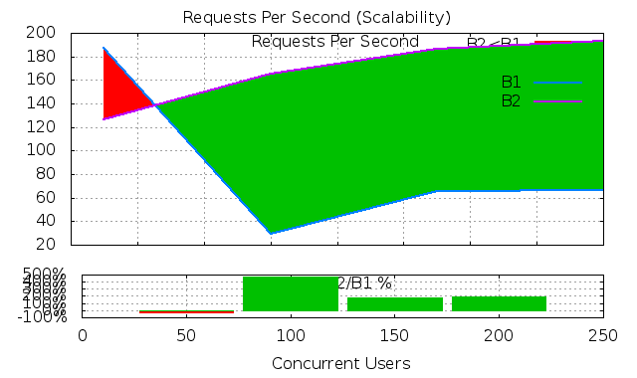
Caching
100 – 300 % increase

Slide 9
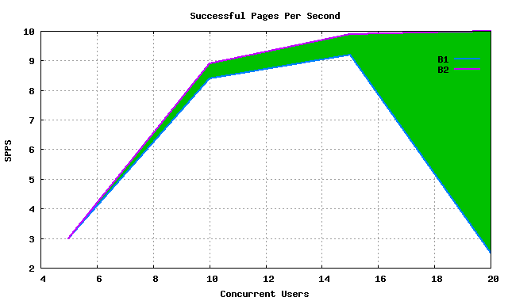
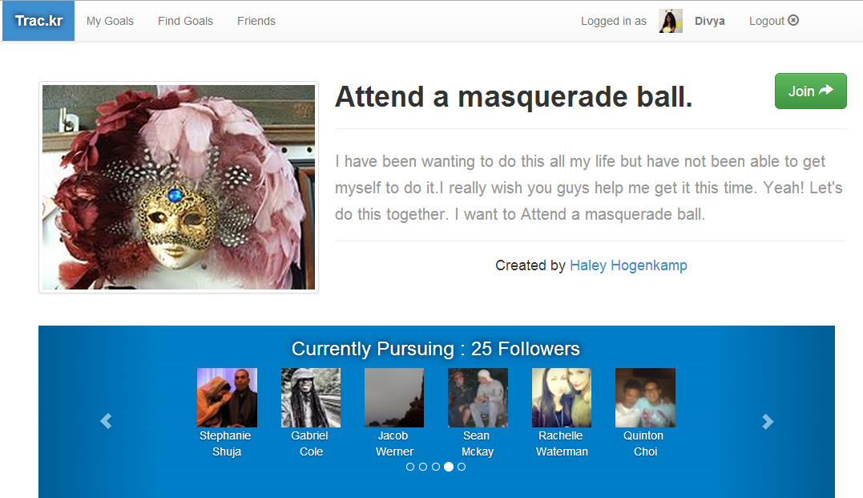
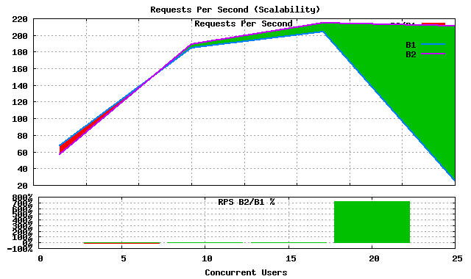
Query Optimization
Replaced multiple “select from … where condition = value” to a single “select from … where condition IN values”

Slide 10

Scalability

Slide 11
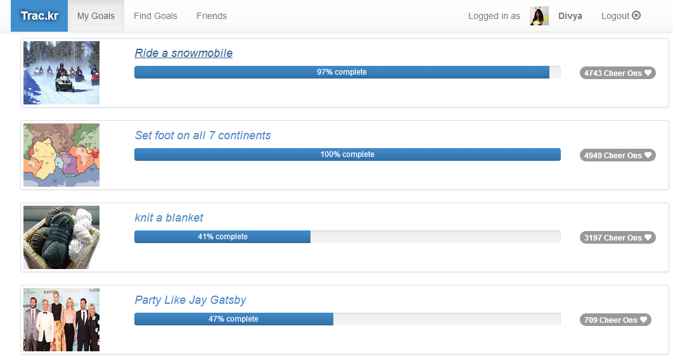
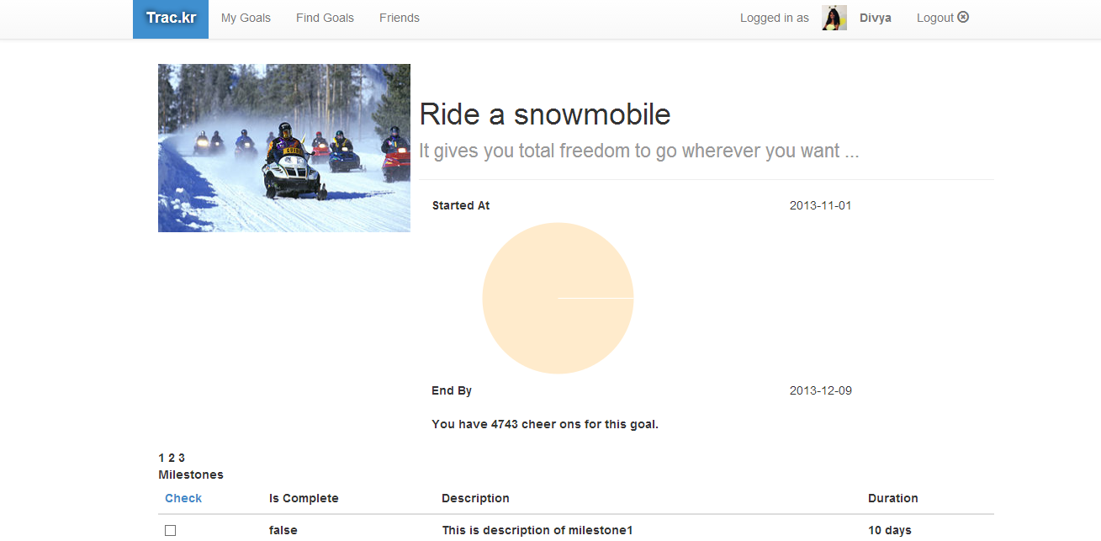
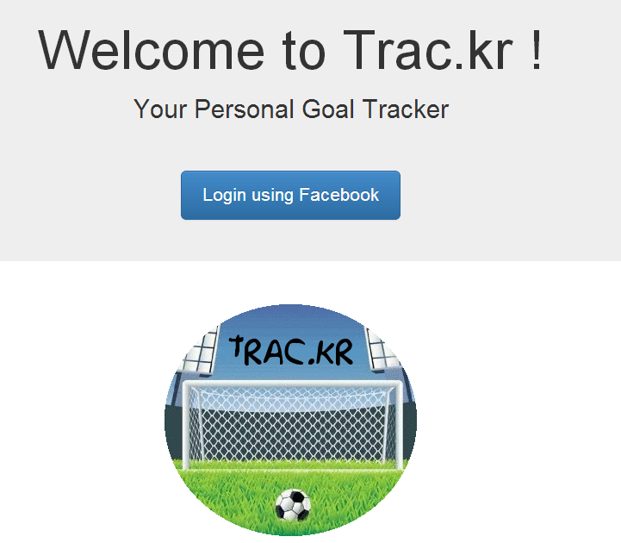
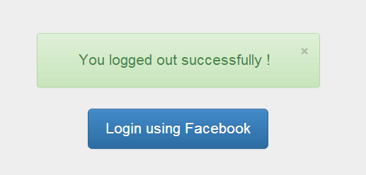
Critical Path:
View Goal Instance
View My Goals
View Goal Instance
Logout
Login
CRITICAL PATH

Slide 12
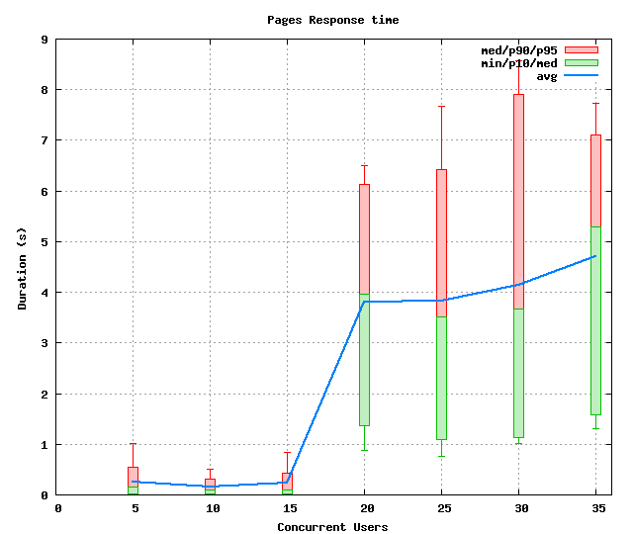
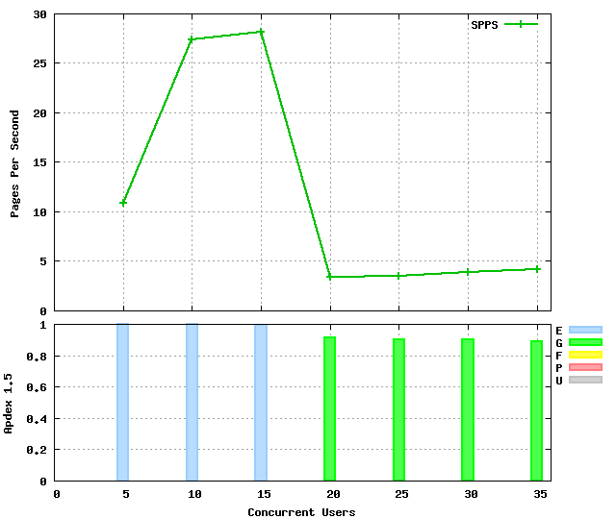
Number of App Instances | Number of Concurrent Users
1 | 150
2 | 450
4 | 1000
8 | 2000

Slide 13

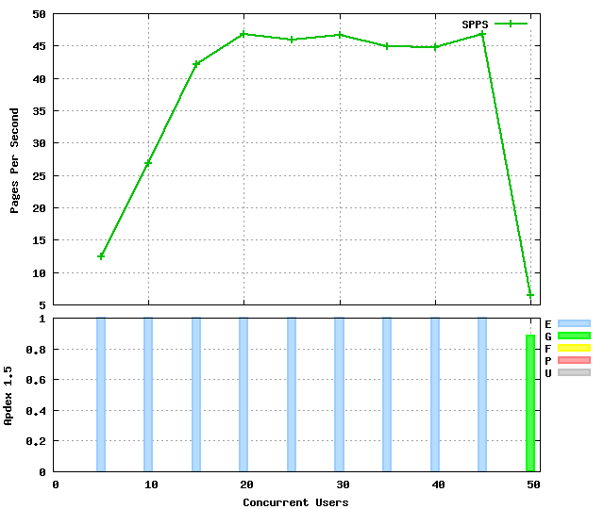
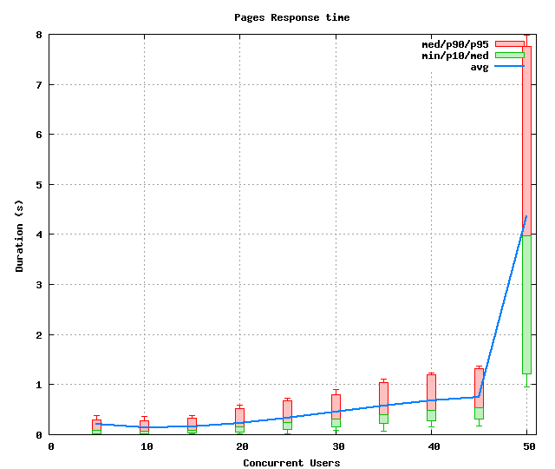
Number of App Instances | Number of Concurrent Users
1 | 150
2 | 450
4 | 1000
8 | 2000

Slide 14
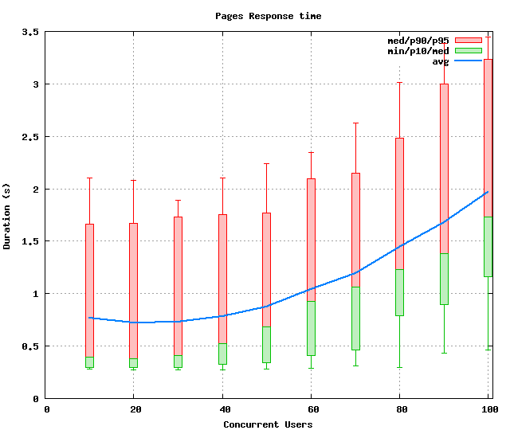
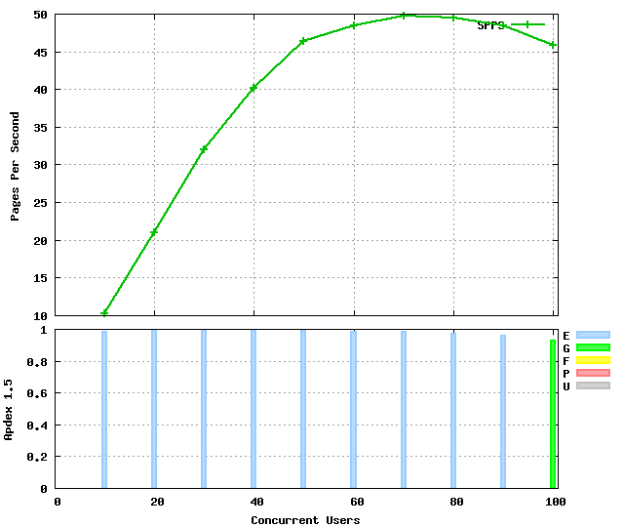
Number of App Instances | Number of Concurrent Users
1 | 150
2 | 450
4 | 1000
8 | 2000

Slide 15
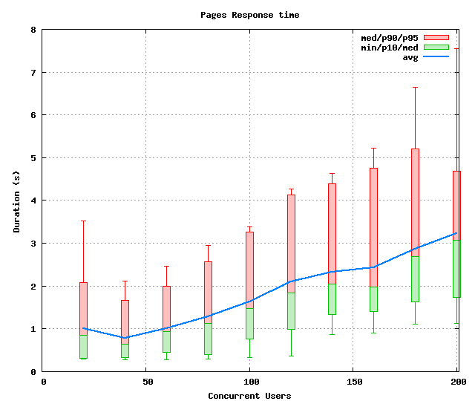
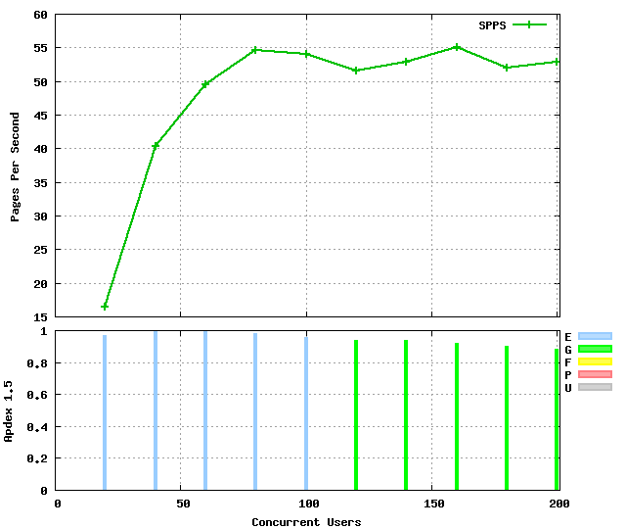
Number of App Instances | Number of Concurrent Users
1 | 150
2 | 450
4 | 1000
8 | 2000

Slide 16
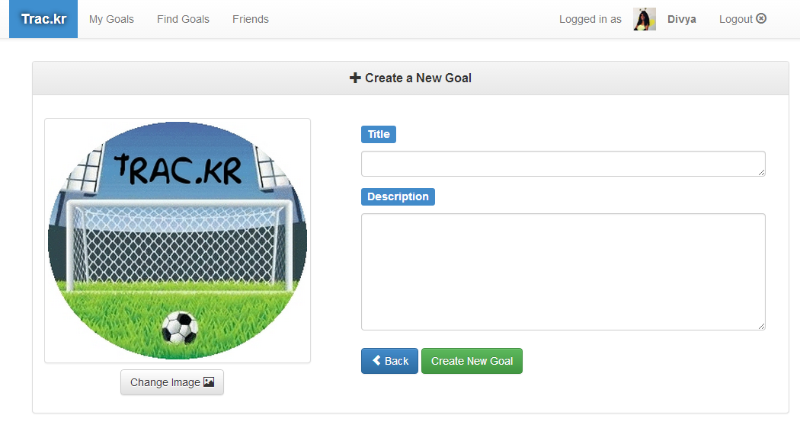
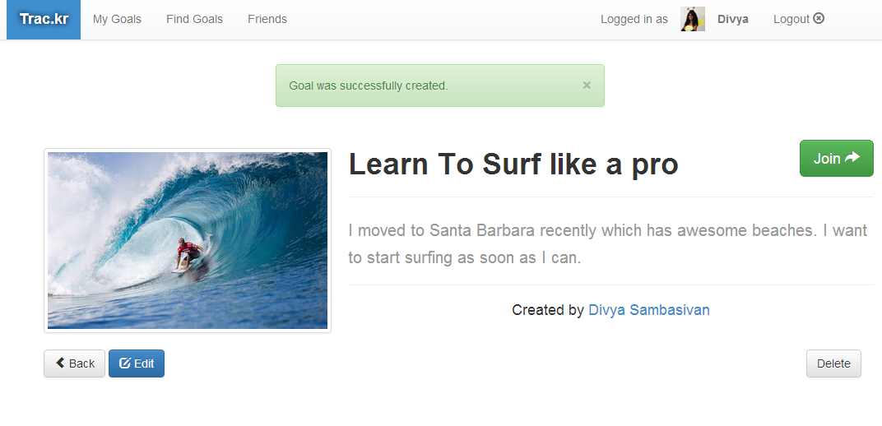
Critical Path:
Create My Own Goal
Login
Create a New Goal
Join the new goal
Logout

Slide 17
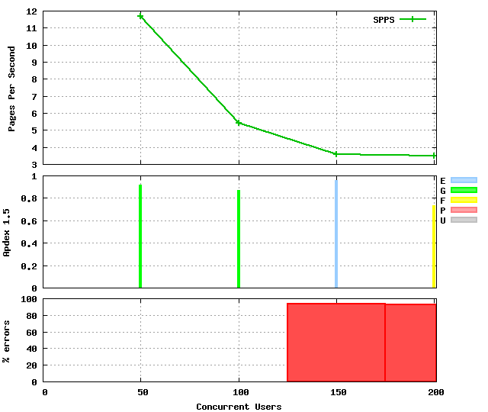
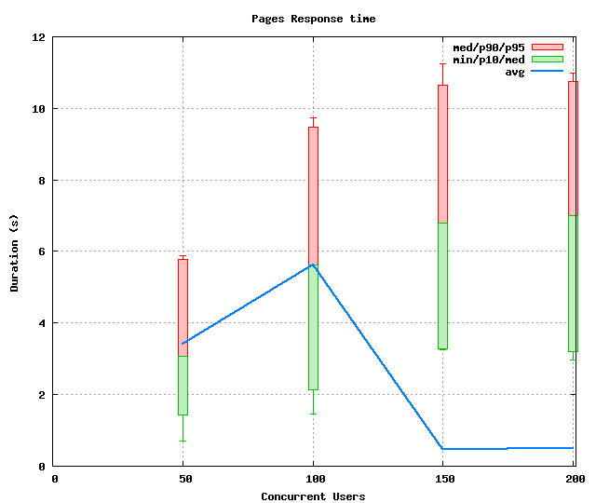
Number of App Instances | Number of Concurrent Users
1 | 100
2 | 150
4 | 250
8 | 400

Slide 18
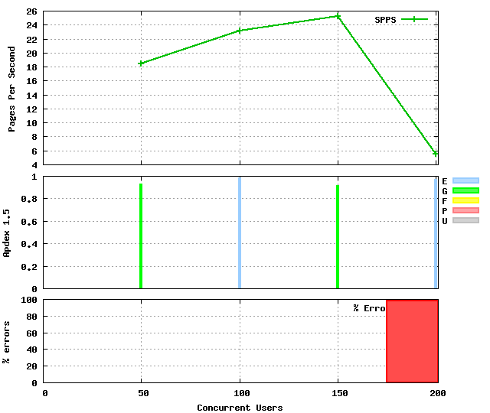
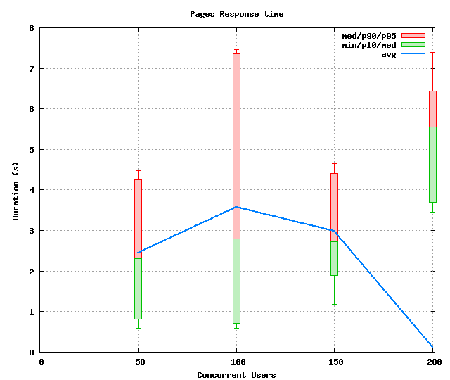
Number of App Instances | Number of Concurrent Users
1 | 100
2 | 150
4 | 250
8 | 400

Slide 19
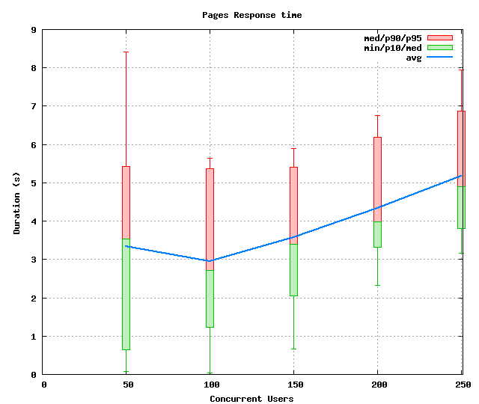
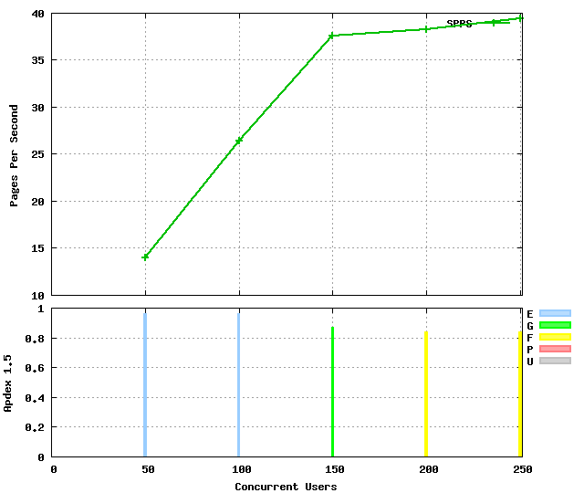
Number of App Instances | Number of Concurrent Users
1 | 100
2 | 150
4 | 250
8 | 400

Slide 20
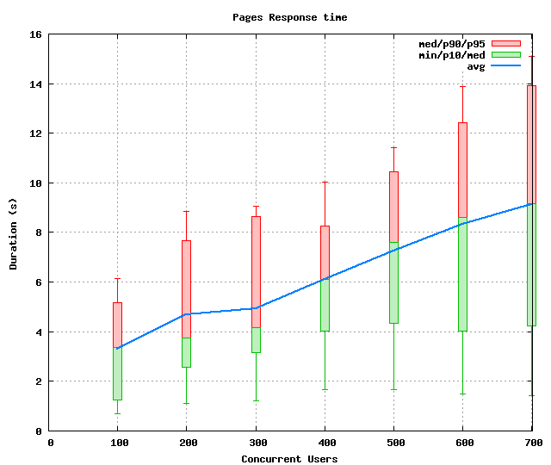
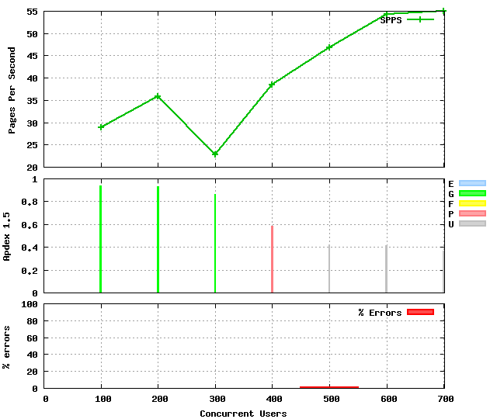
Number of App Instances | Number of Concurrent Users
1 | 100
2 | 150
4 | 250
8 | 400

Slide 21

Availability

Slide 22
Amazon Relational Database Service
Replication
Replication to enhance availability and reliability for production workloads.
Automatically patches the database software
Multi-AZ Deployment
Automated fail-over from primary database to a synchronously replicated secondary database in case of a failure
BackUp And Recovery
Backs up your database
Storing the backups for a user-defined retention period
Enabling point-in-time recovery.
Read Slave
Scale out beyond the capacity of a single cloud relational database deployment for read-heavy database workloads

Slide 23
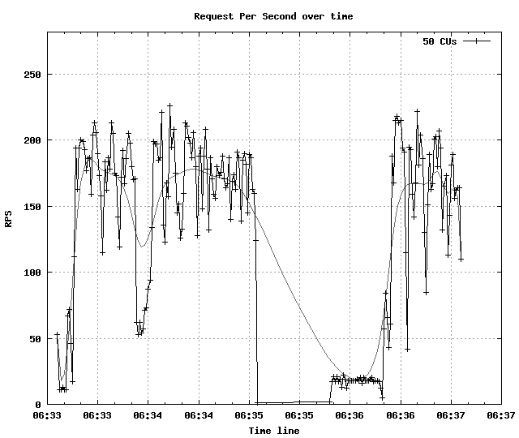
Availability Testing
Goal Index page

Slide 24

Conclusion

Slide 25
Industry Practices
Pair Programming
Agile Methodology
Fast Paced
Incremental Development
Easier to Plan
Quick Execution
Flexible
New
Hit a wall
Faster
Easier
Fun

Slide 26
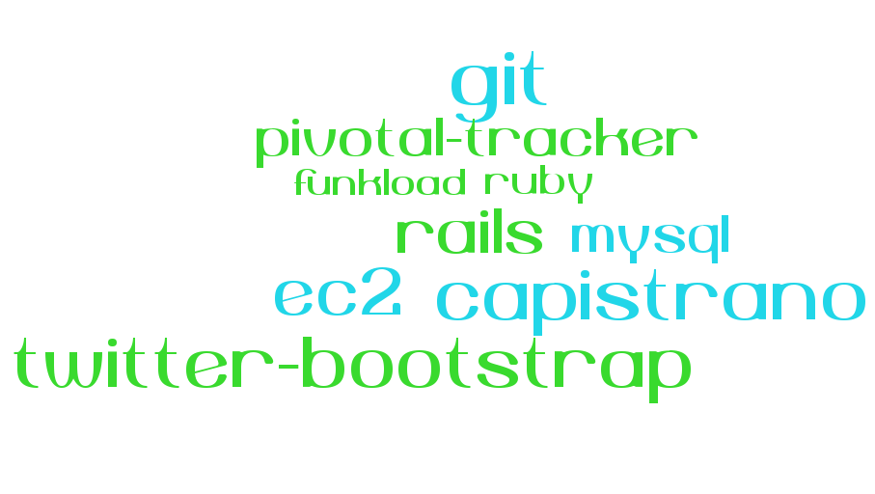
Tools and Languages

Slide 27
Some Details
EC2
Rails
Facebook API
Security Groups
Load Balancers
RDS
S3
Some Useful Gems
Paper Clip – to connect to S3
Koala – Facebook API
Will Paginate – Pagination and Search
Nokogiri – Web Page Scraping
OAuth2
Batching

Slide 28


Large Scale Applications
Scale
Design
Availability
Always have redundancy
Keep it simple
Optimize
Need not be expensive
Identify bottlenecks early
Murphy’s law
Huge Implications – Reputation and Money

Slide 29

Future Enhancements

Slide 30
Future Enhancements
Features
Comments
Availability
Extend Applications to Multiple Geographic Zones
Ranking – Friends and Goals
Use Amazon Route 53

Slide 31
Thank You :)

